Slide 1
Analyzing the Neighborhoods in Mumbai for Starting a Restaurant
By: Raunak Bhutoria
Date: August 4, 2020

Slide 2

Introduction
Mumbai is the financial capital of India and is one of the most densely populated cities in the world
It is one of the major hubs in the world
The multi-cultural nature of the city brings with it numerous cuisines from all over the globe
Business owners and entrepreneurs might be looking to start a new restaurant in Mumbai
The task is to identify neighborhoods that have the potential of being good locations for starting a new restaurant
Provide recommendations to key stakeholders
Figure 1: Mumbai view

Slide 3
Data Collection
The following data was collected for this project:
Neighborhood data of Mumbai from https://en.wikipedia.org/wiki/List_of_neighborhoods_in_Mumbai
Geographical coordinates of Mumbai and all neighborhoods in Mumbai using GeoPy and Geocoder packages in python
Venue data for all neighborhoods in Mumbai using Foursquare API
Data cleaning was performed to clean the Mumbai neighborhood dataset
Latitude and longitude values on Wikipedia were cross-referenced by the values obtained through Geocoder for each neighborhood
The values from Wikipedia were replaced by the values provided by Geocoder if the absolute difference between the values was greater than 0.001
The venues dataset was modified to display the neighborhood name and the top 10 most common venues for that neighborhood
The final datasets have been shown on the next slide

Slide 4
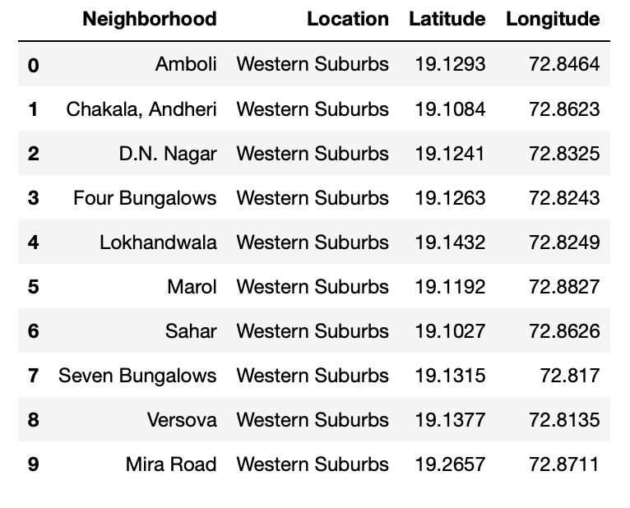
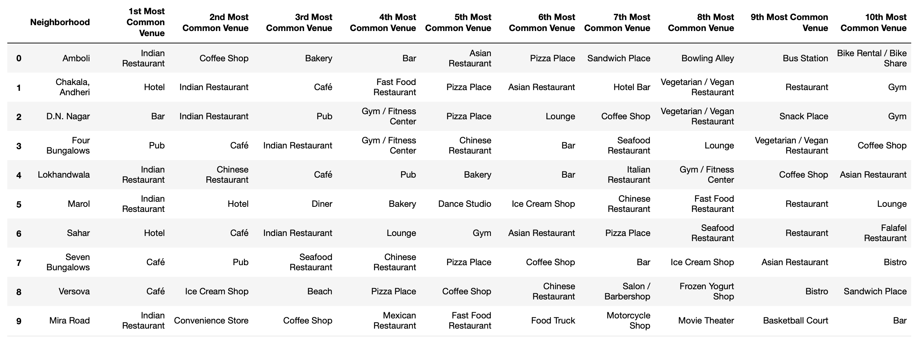
Datasets
Figure 3: First 10 rows of top 10 most common venues for all neighborhoods
Figure 2: First 10 rows of Mumbai Neighborhood Dataframe

Slide 5
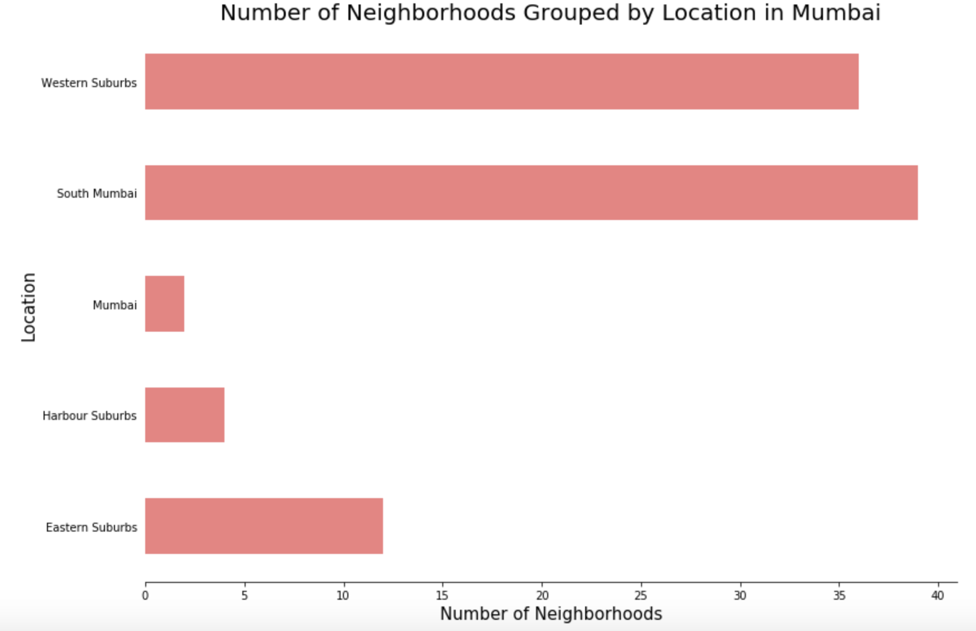
Methodology
Data Visualization
Mumbai neighborhoods data was plotted for providing better understanding
The graph alongside depicts the number of neighborhoods in each location of Mumbai
All neighborhoods on the outskirts of Mumbai have been termed as “Mumbai”
The graph shows that Western Suburbs and South Mumbai contain the highest number of neighborhoods
Figure 4: Number of neighborhoods grouped by location

Slide 6
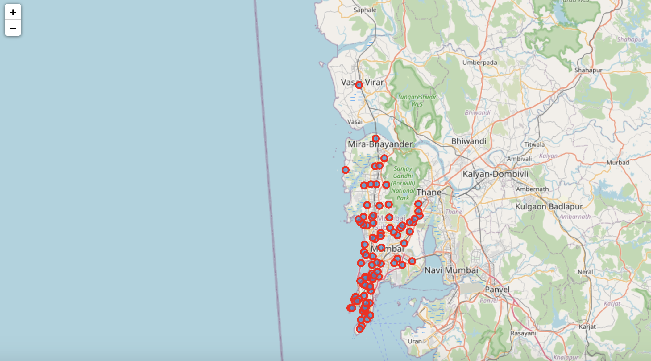
Methodology Continued
Data Visualization
The Folium library in python was used to plot the neighborhoods in Mumbai on a map
The map alongside depicts the spread of all neighborhoods across Mumbai
Figure 5: The neighborhood spread across Mumbai

Slide 7
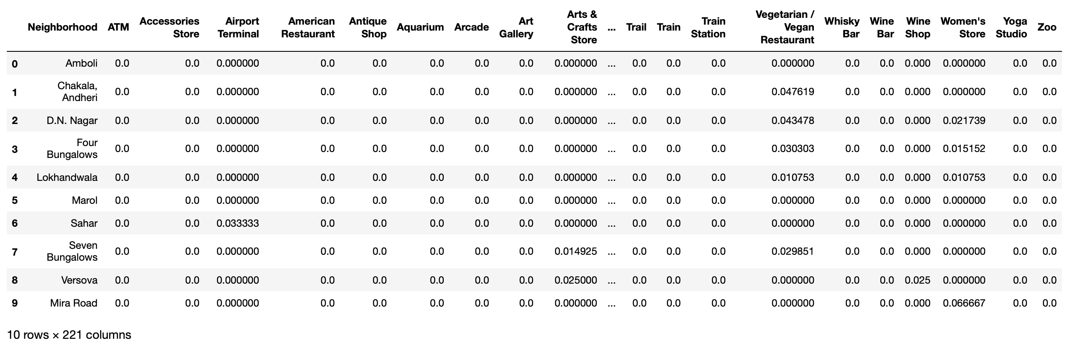
Methodology Continued
One-hot Encoding
One-hot Encoding was used to encode venue categories to numeric values with 1 if a neighborhood venue belongs to a category and 0 if a neighborhood venue does not belong to a category thus creating a sparse matrix
Necessary for building the unsupervised learning model
Figure 6: One-hot Encoding resulting dataframe

Slide 8
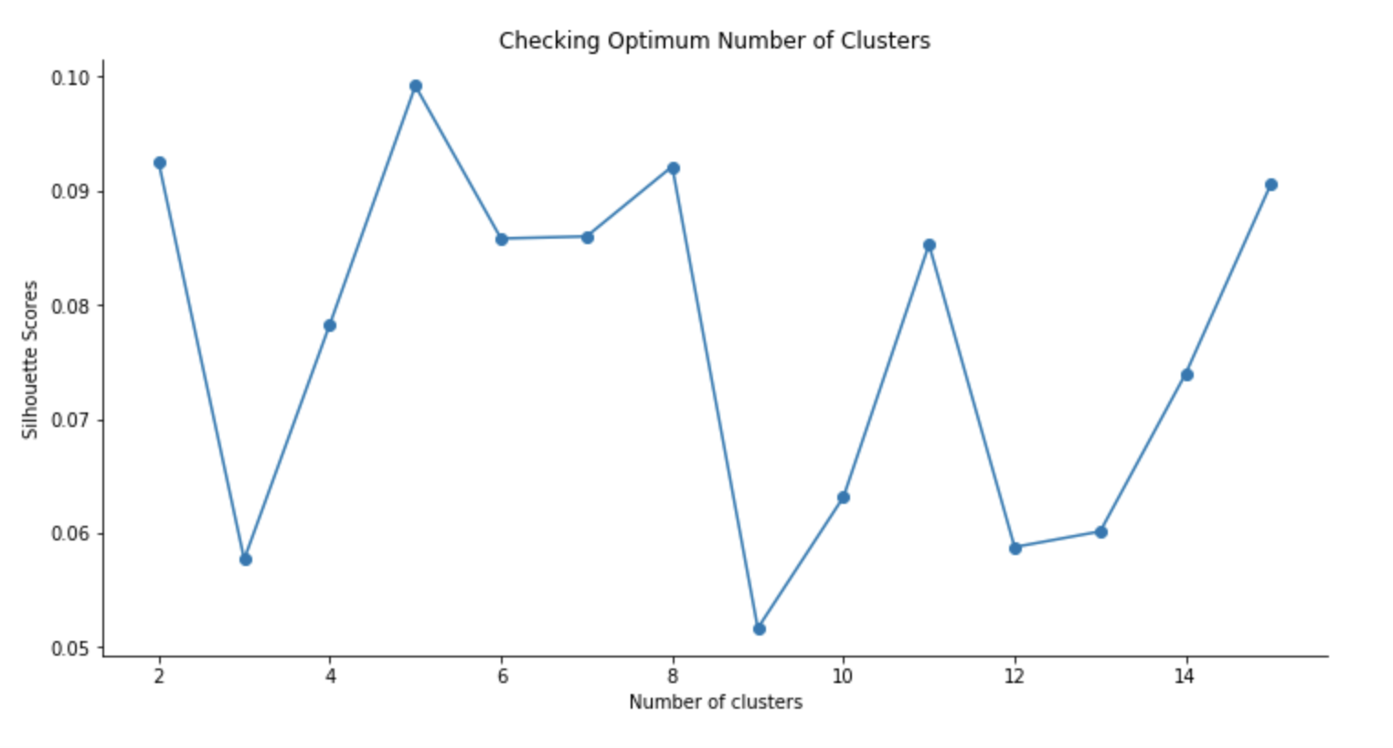
Methodology Continued
Unsupervised Learning Model
KMeans clustering was used to cluster neighborhoods in Mumbai based on the category of venues present in the neighborhoods
n_clusters = 5 was used to build the model based off of the Silhoutte score plot
The plot shows a maximum value for 5 clusters and thus this was used in our model
Figure 7: Silhouette scores for varying number of clusters in KMeans clustering

Slide 9
Results
Each neighborhood received a cluster label based on clustering by the KMeans algorithm
The Cluster Label column along with the Location, Latitude, and Longitude columns were added to the top 10 most common venues dataframe to provide the final results
This dataframe is shown on the next slide

Slide 10
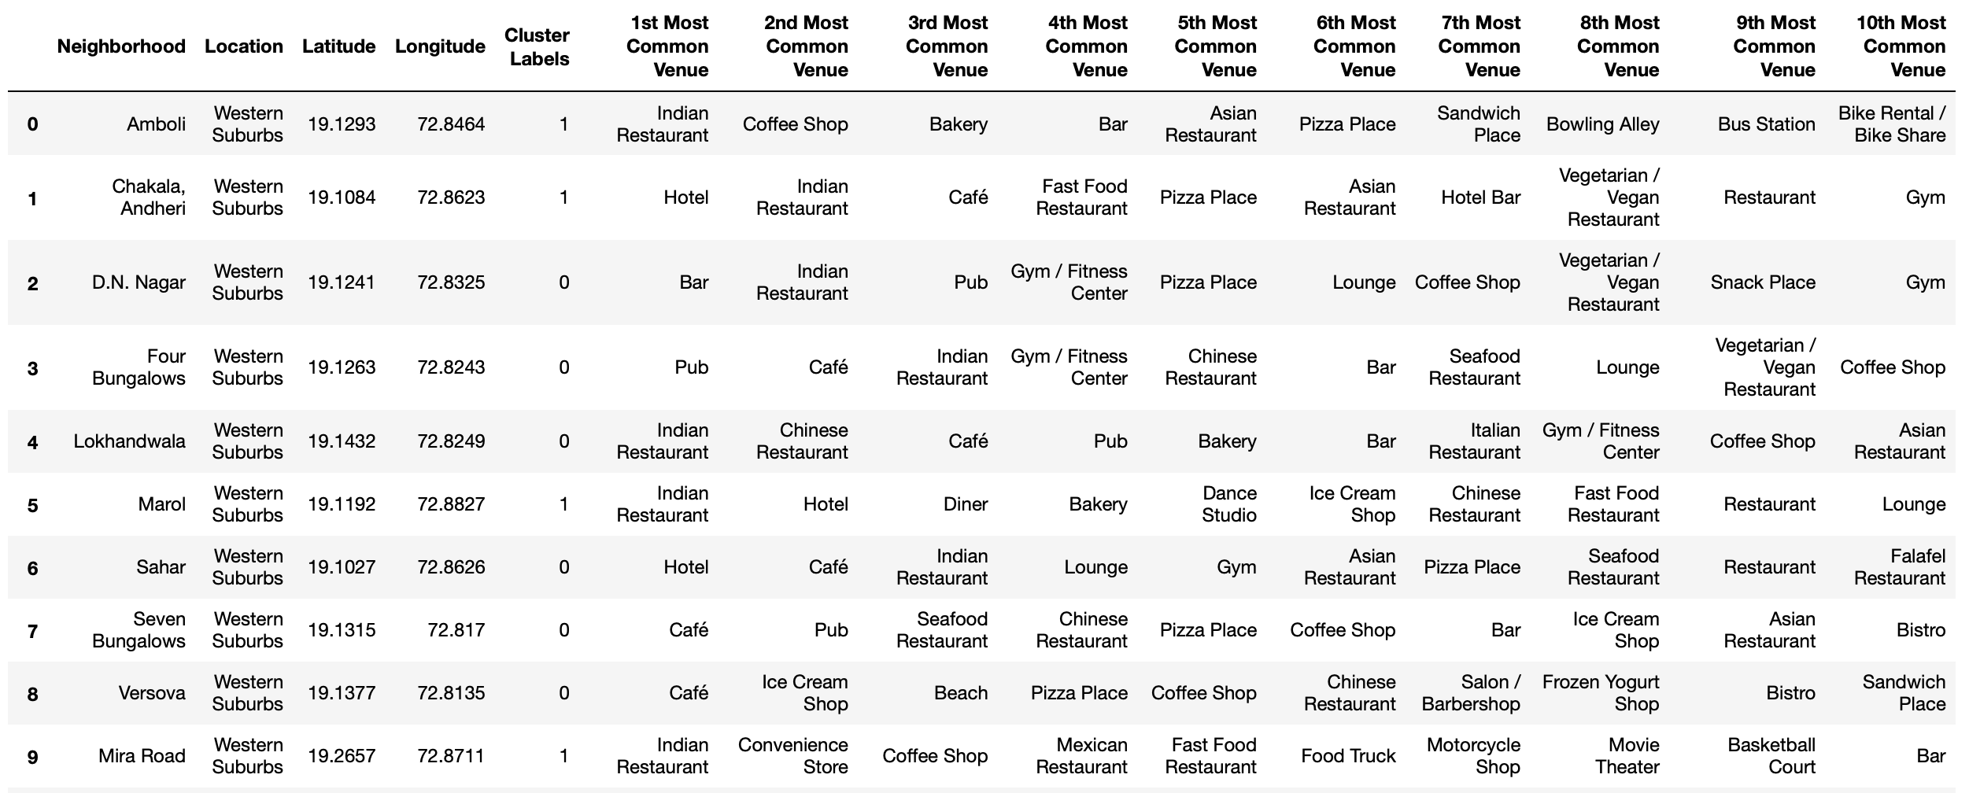
Results Continued
Figure 8: First 10 rows of clustering neighborhoods in Mumbai dataframe

Slide 11
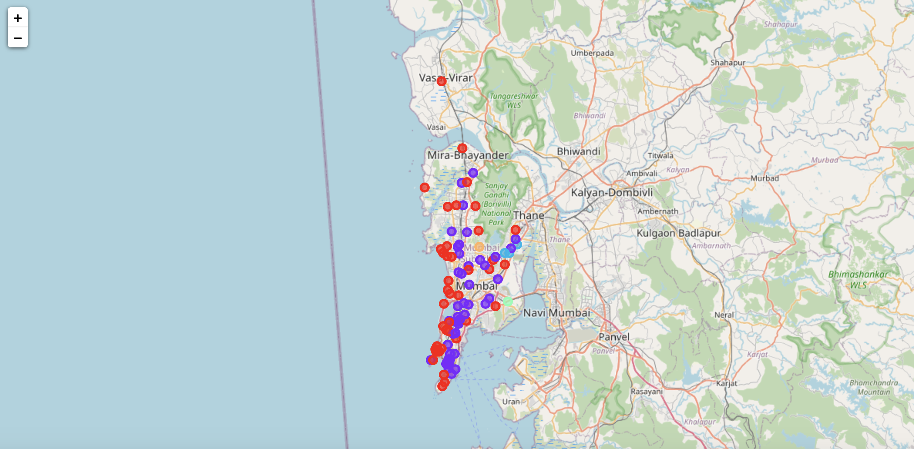
Results Continued
Visualization of clusters was done using Folium in python
Figure 9: Visualizing the clustering of neighborhoods in Mumbai

Slide 12
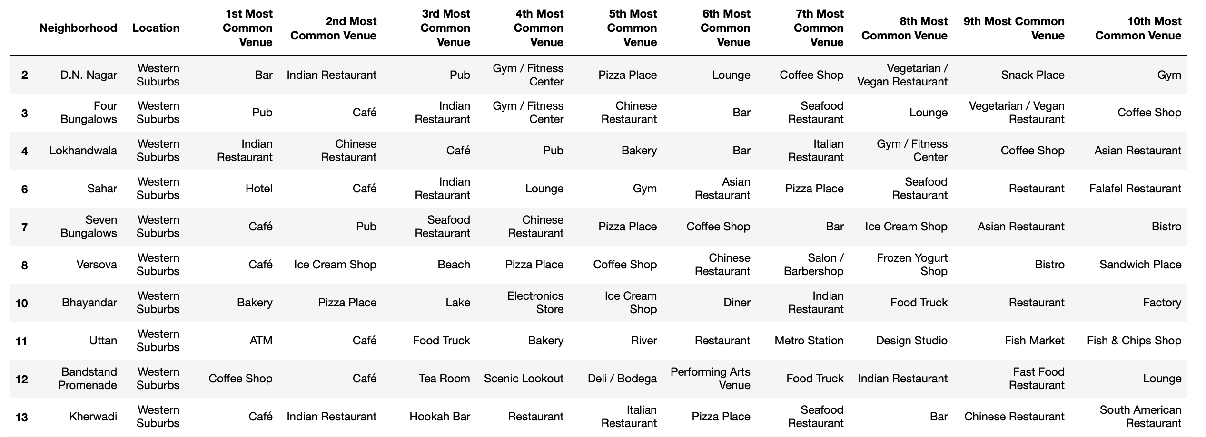
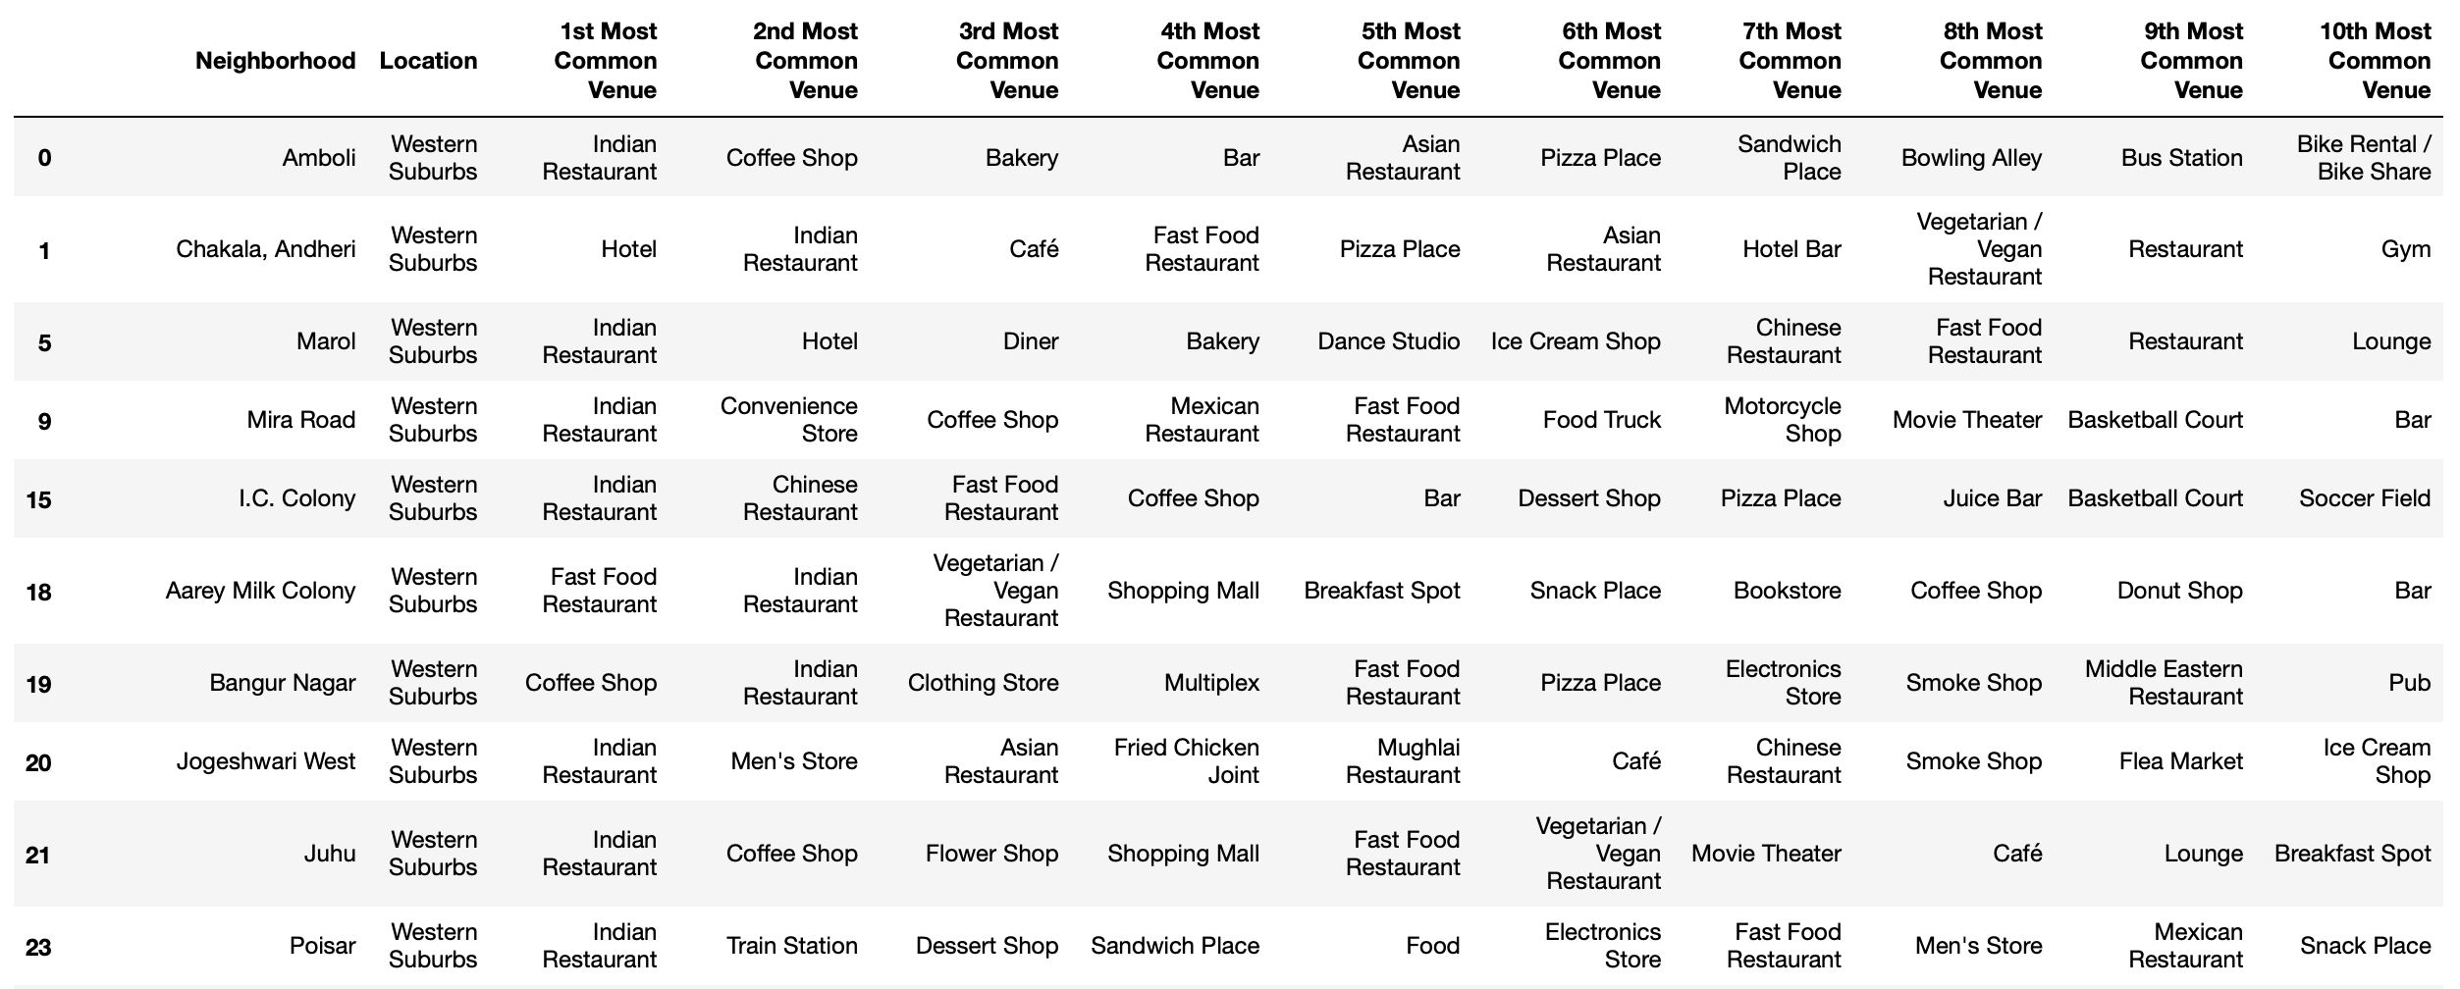
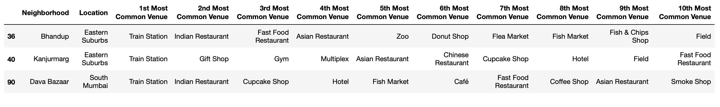


Results Continued
Can also view the data in each cluster individually for analysis
Figure 10: Cluster 1
Figure 11: Cluster 2
Figure 13: Cluster 4
Figure 12: Cluster 3
Figure 14: Cluster 5

Slide 13
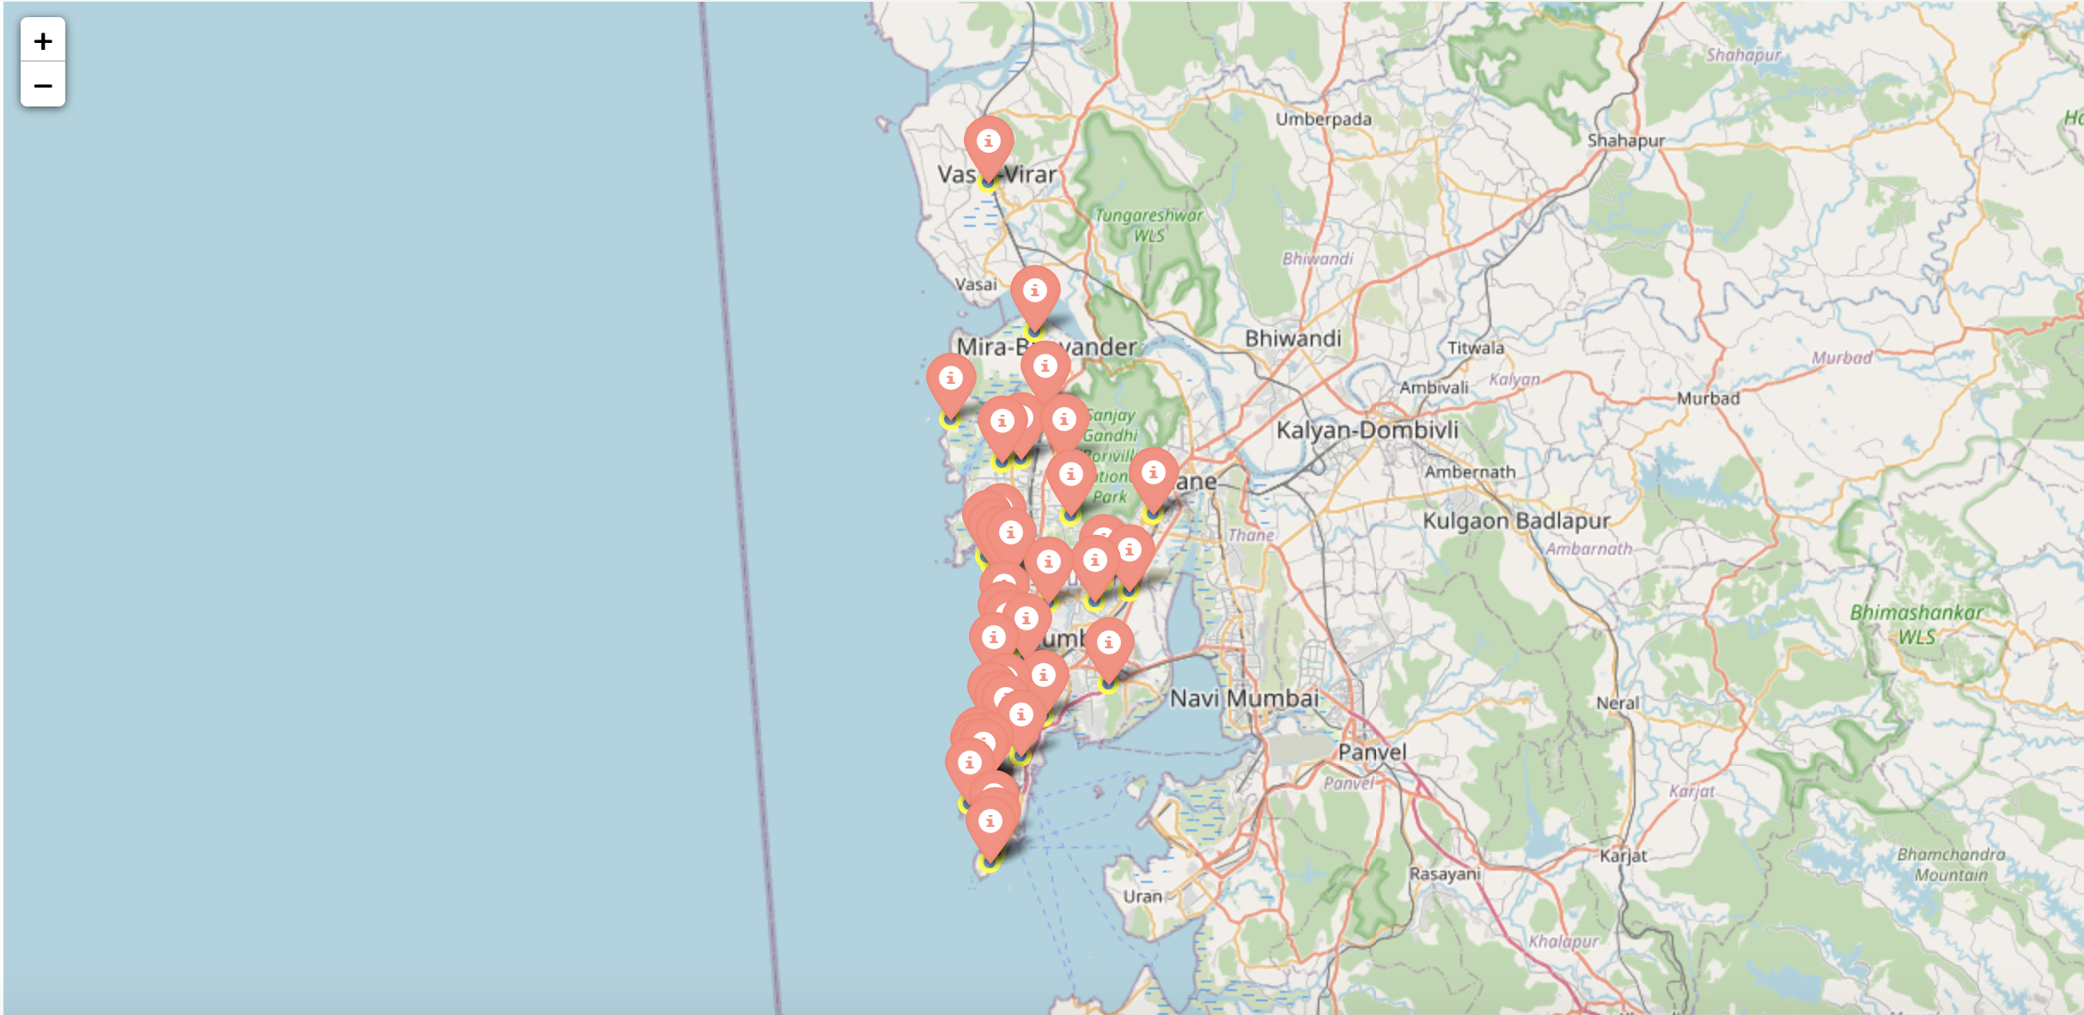
Discussion
By analyzing the different clusters, it is evident that neighborhoods in cluster 3, 4, and 5 are not well suited for a new restaurant since they contain a high degree of other venues like train station, bus station, fish market, gym, performing arts venue and smoke shop
Comparing clusters 1 and 2, we find that neighborhoods in cluster 2 contain many other venues like soccer field, flea market, smoke shop, gym, train station, dance studio, music store and cosmetics shop
Neighborhoods in cluster 1 contain a much higher degree of food joints
Thus, the most optimal neighborhoods for starting a restaurant are in cluster 1
The map alongside shows the neighborhoods in cluster 1 plotted on a map of Mumbai
Figure 15: Neighborhoods most suited for starting a new restaurant

Slide 14
Conclusion
In this project, the neighborhoods in Mumbai, India have been successfully analyzed for determining which would be the best neighborhoods for opening a new restaurant
Based on the analysis carried out, neighborhoods in cluster 1 are recommended as locations for the new restaurant
The stakeholders and investors can further tune this by considering various other factors like transport, legal requirements, and costs associated which were out of the scope for this project and thus were not considered.

